Slide 1
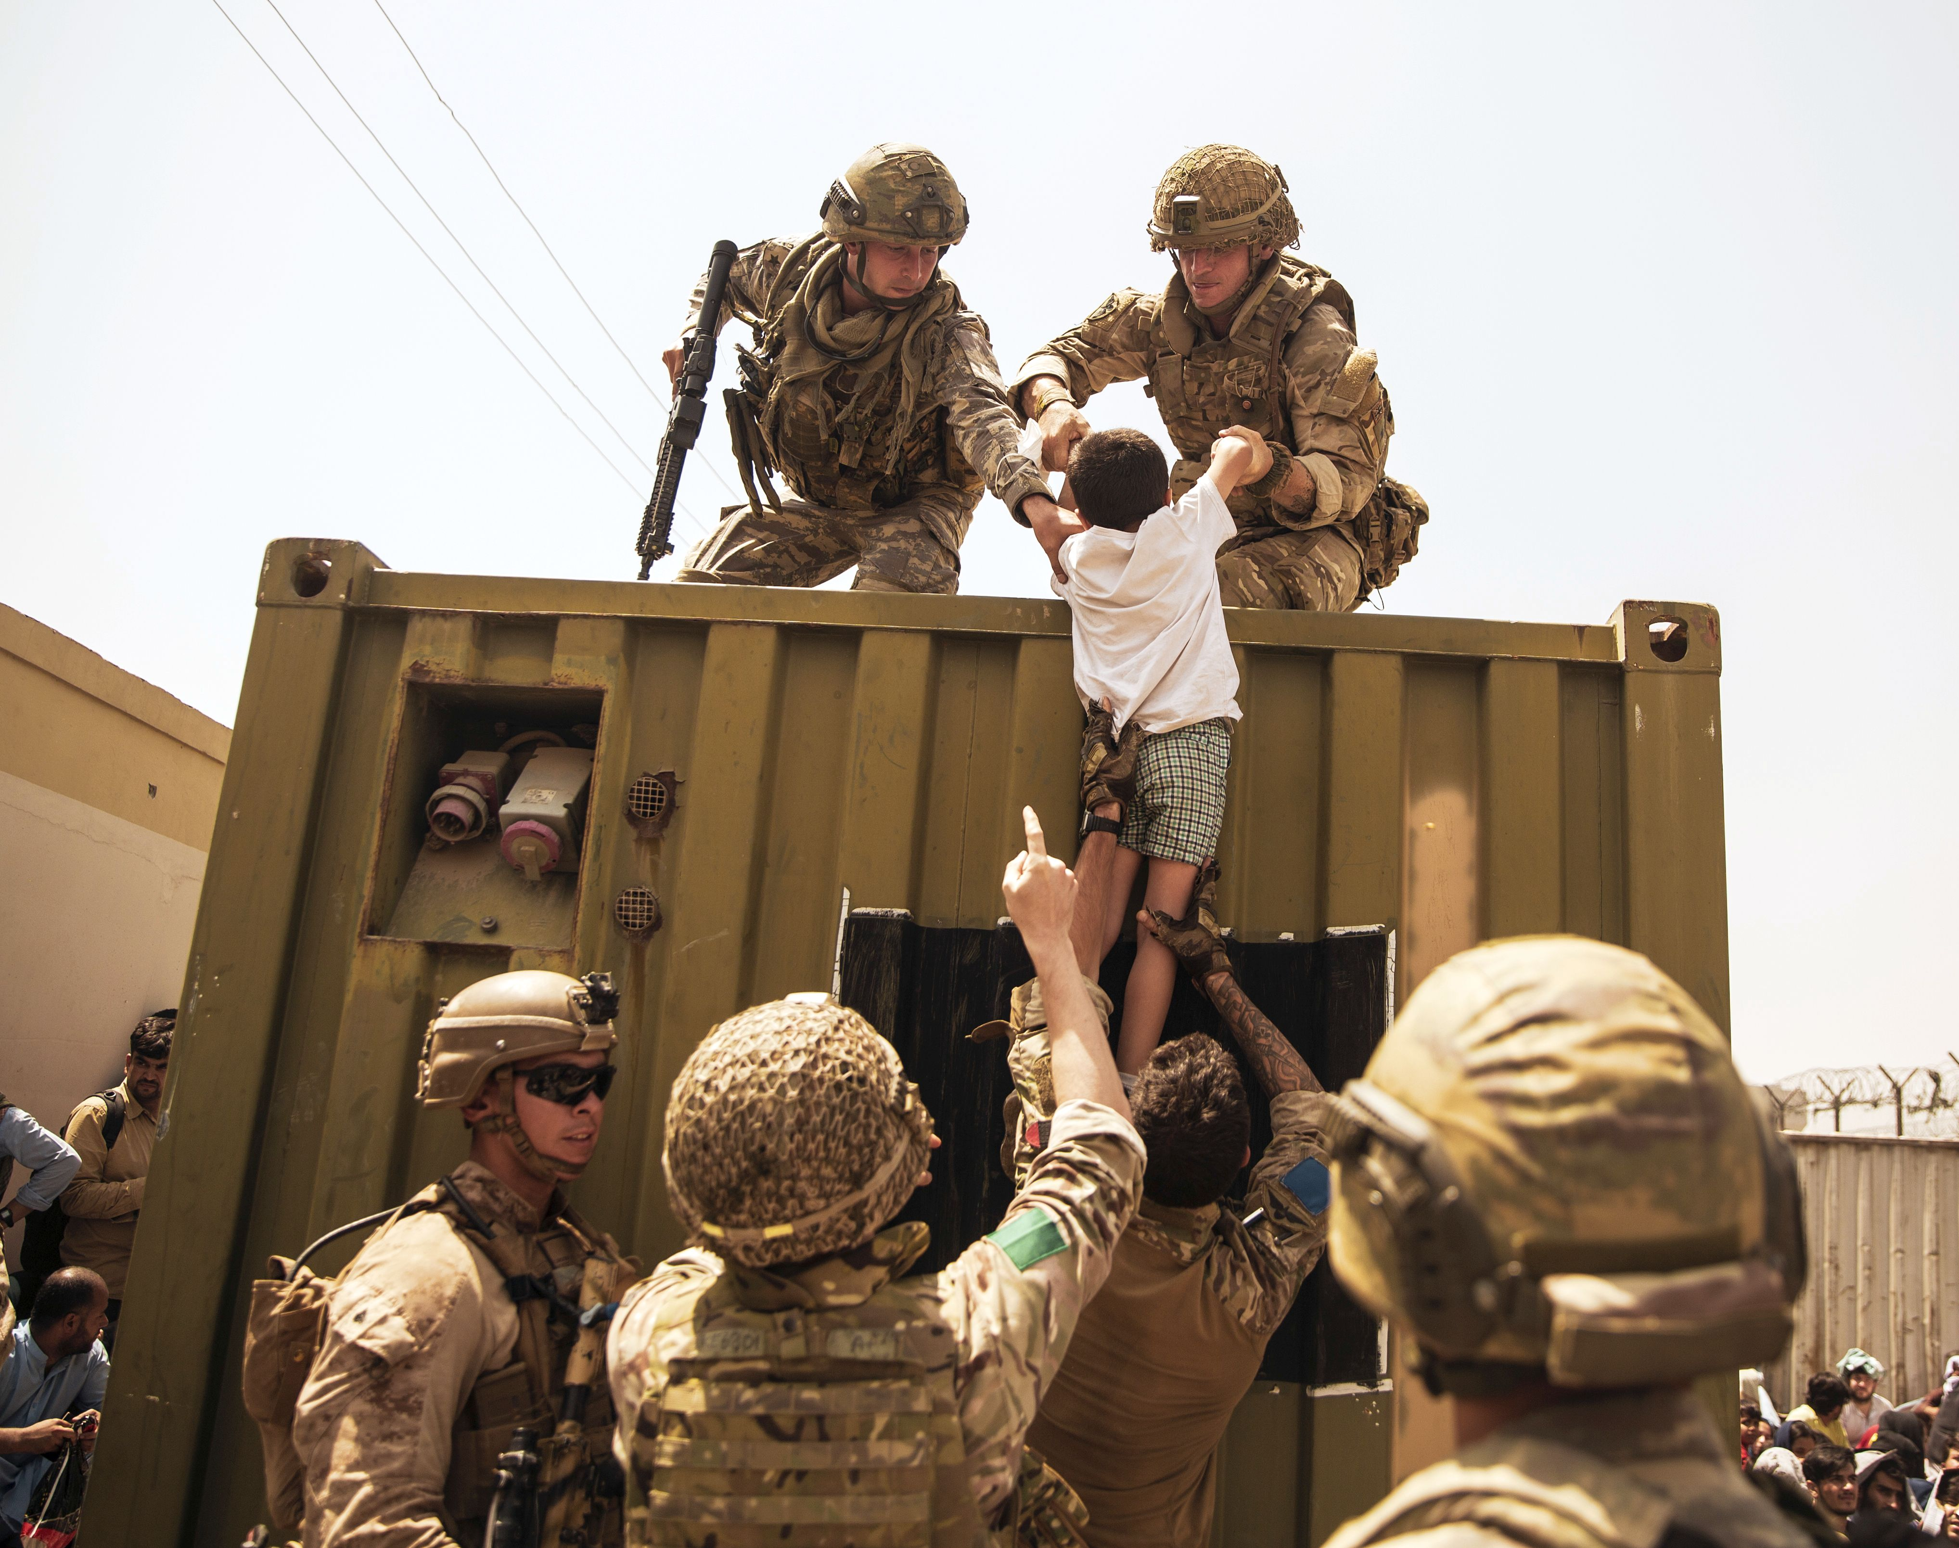
Operation Pitting
Extractions of Afghanistan

Slide 2
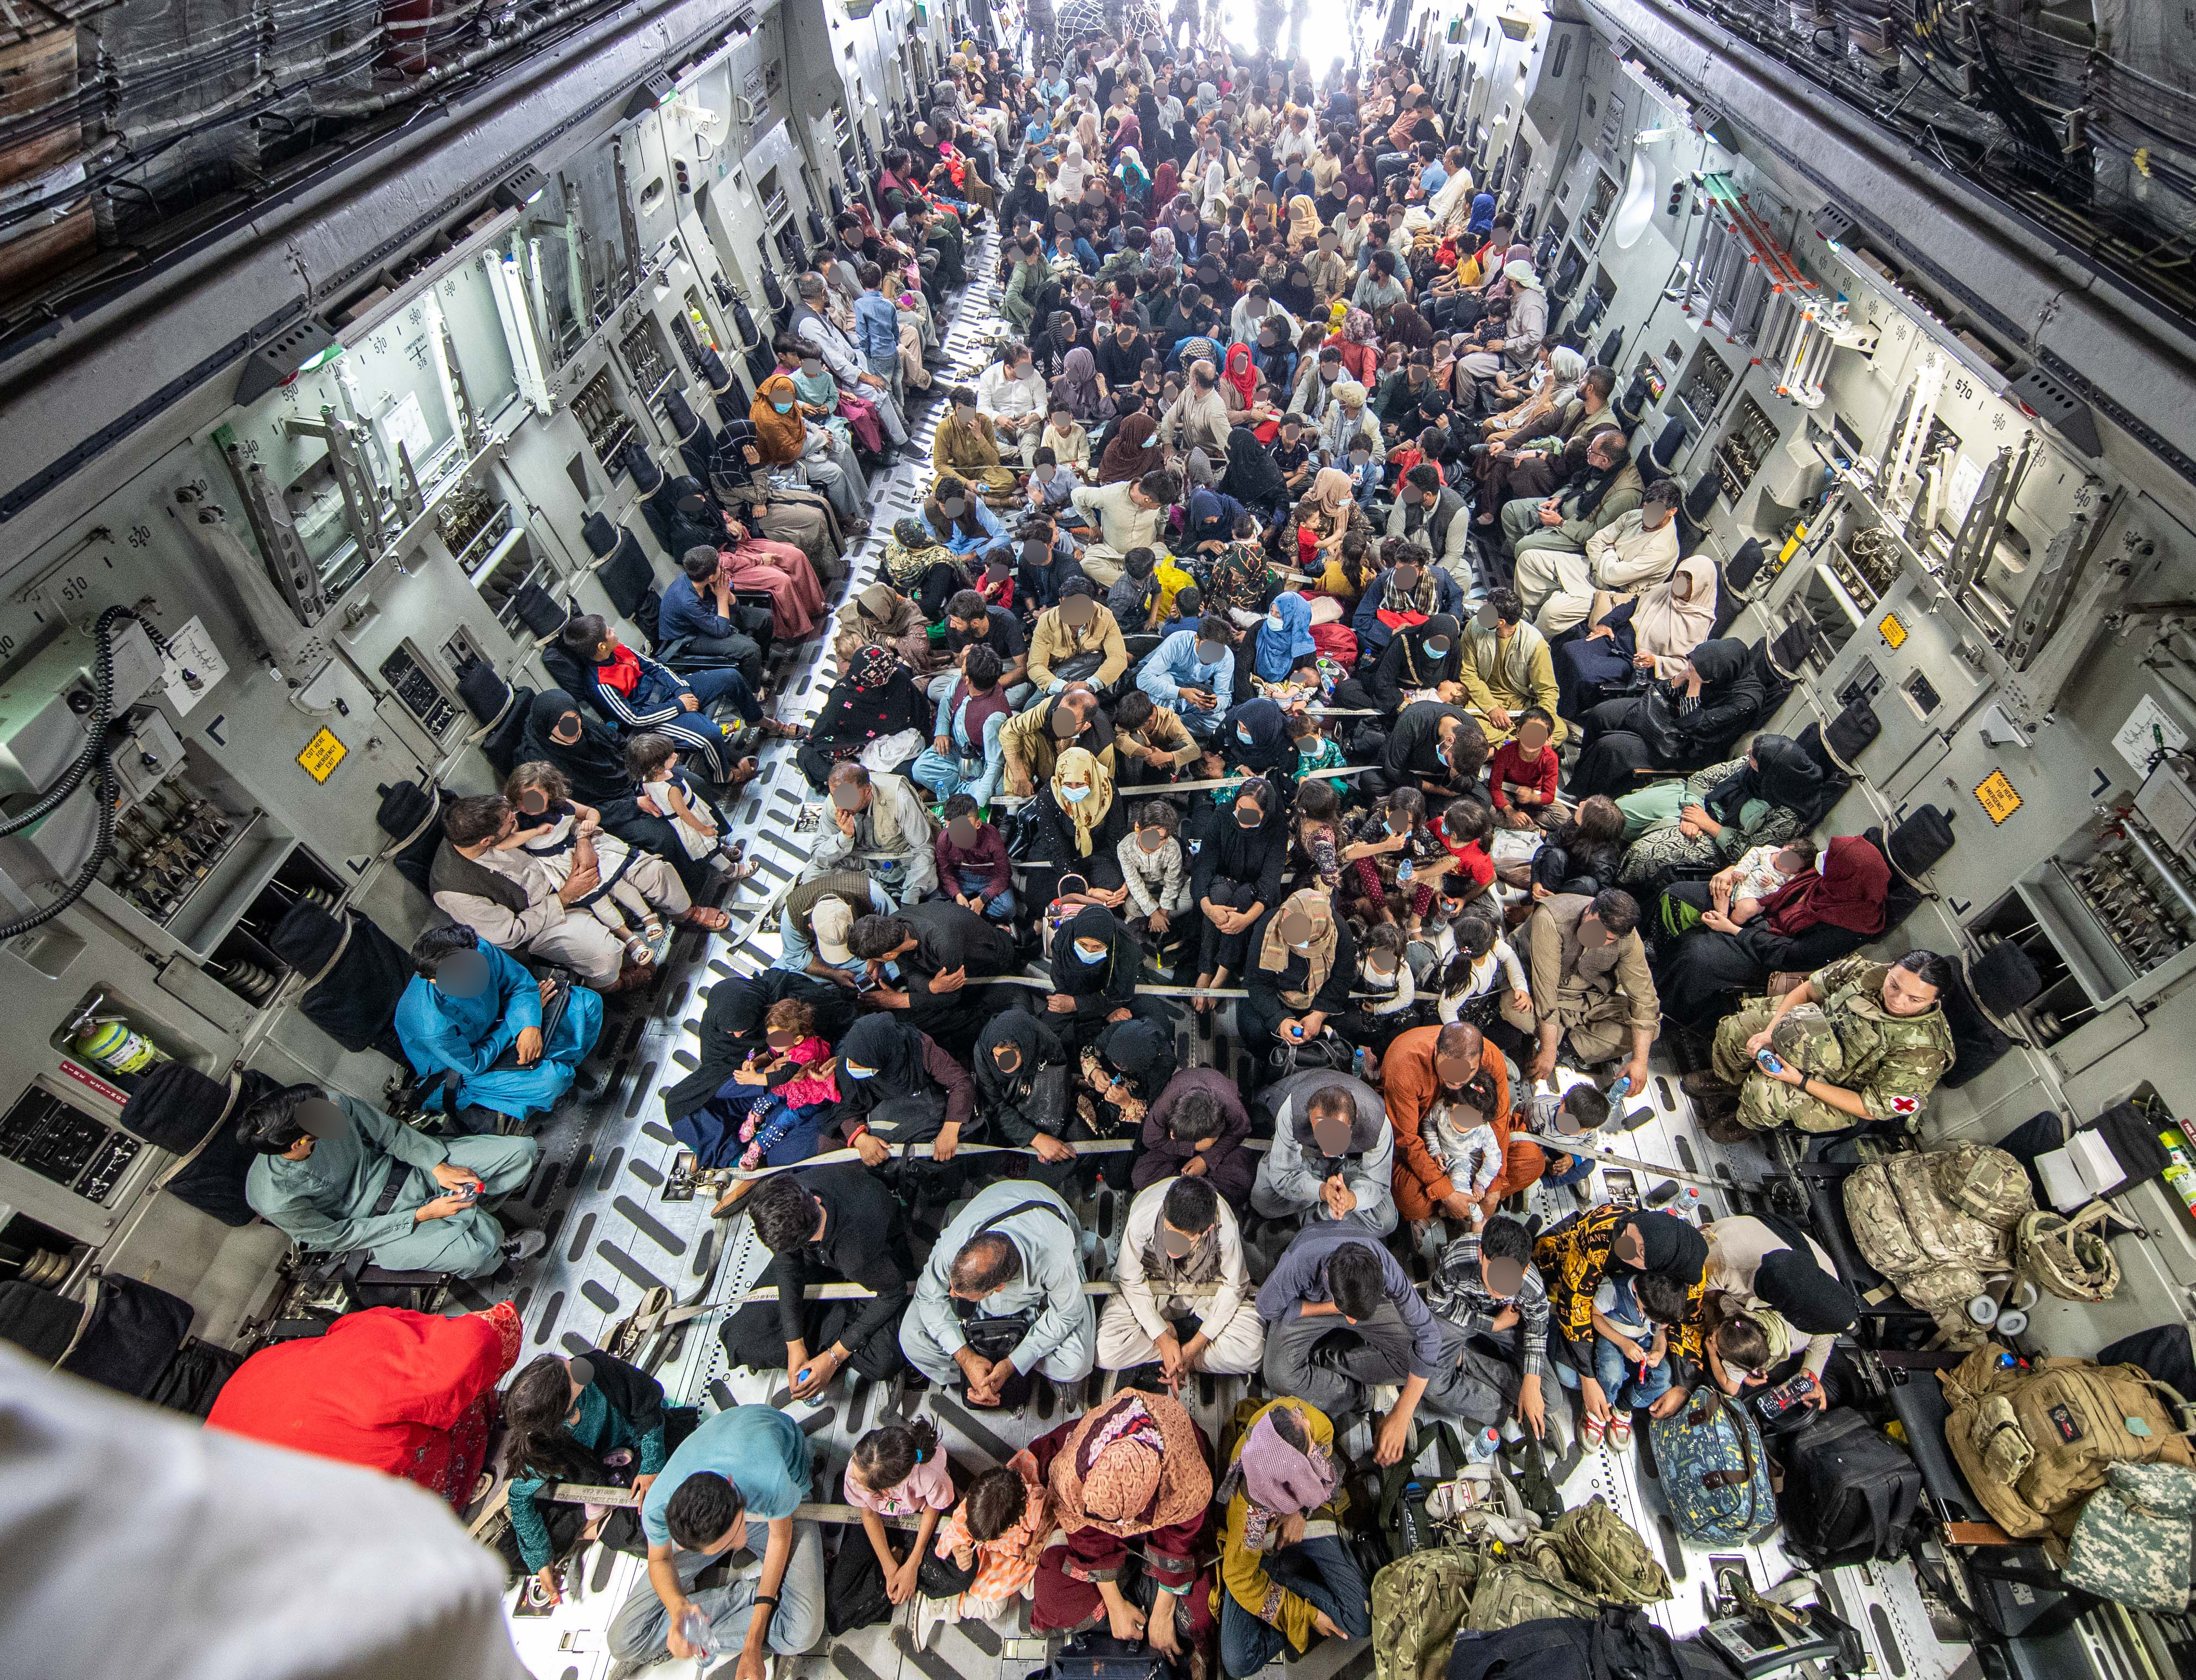
Introduction
What was Op Pitting?
Announced in 13 August 2021, commanded from permanent HQ in Northwood, London & lasted 14 days
Conducted by the British Army to help the US with Military support & evacuation in Afghanistan
People involved:
600 military personnel
16 air assault brigades
A home office team
Over 15,000 Afghans recovered within the 14 days

Slide 4
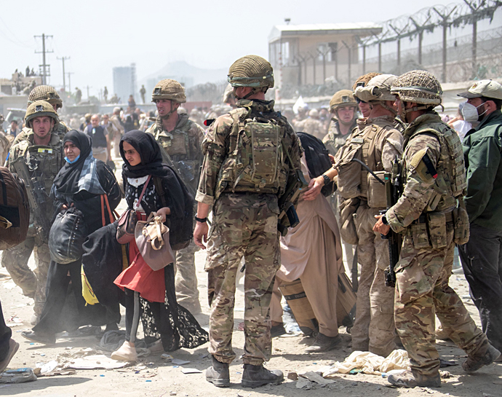
Who Was Evacuated?
British Nationals
Embassy Staff
Afghans (ARAP)

Slide 5
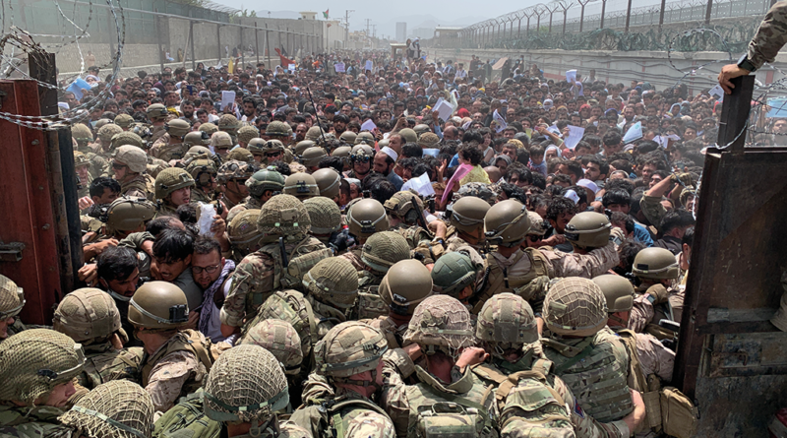
Case Study 1
Some British Council Staff not eligible for ARAP
Most British Council staff were evacuated to the UK during Operation Pitting in August 2021, however more than 180 British Council English teachers across the country were not deemed eligible for ARAP on the grounds they were contractors (though some of the British Council contractors did get ARAP approval)
They were arguably more at risk than British Council Kabul employees, as they were visibly teaching a foreign language, and promoting foreign values including equality and diversity. They had been living in hiding ever since the Taliban took over Afghanistan.
It was only on 6 January 2022, 5 months after Operation Pitting, that the Government announced that British Council contractors would be prioritised under the Afghan Citizens Resettlement Scheme (ACRS). Out of the 180, 85 teachers were classified as being at “very high risk” and further 90 or so are deemed to be at “high risk”.

Slide 6
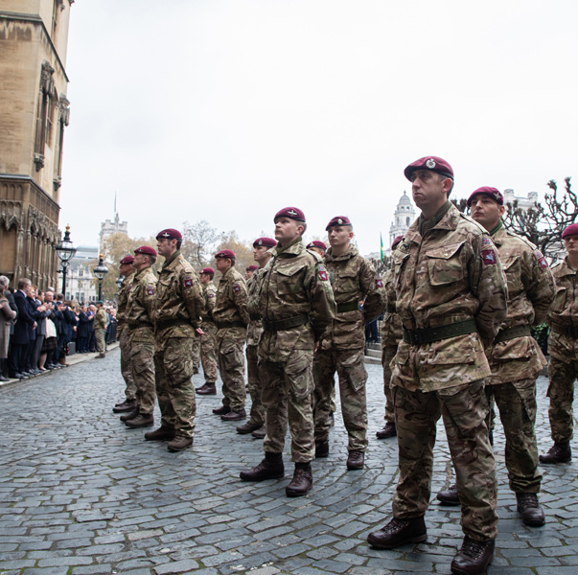
Political, Military, Economical, Social, Infrastructure Impact
Military & Social - This case study affects the view of the military negatively in the public eye as the British Council english teachers weren’t eligible for ARAP due to being contractors though other contractors were eligible and evacuated.
Social – Successfully evacuated 15000 people in 14 days and maintained control over the situation the entire time no matter how hectic it was at times.

Slide 7
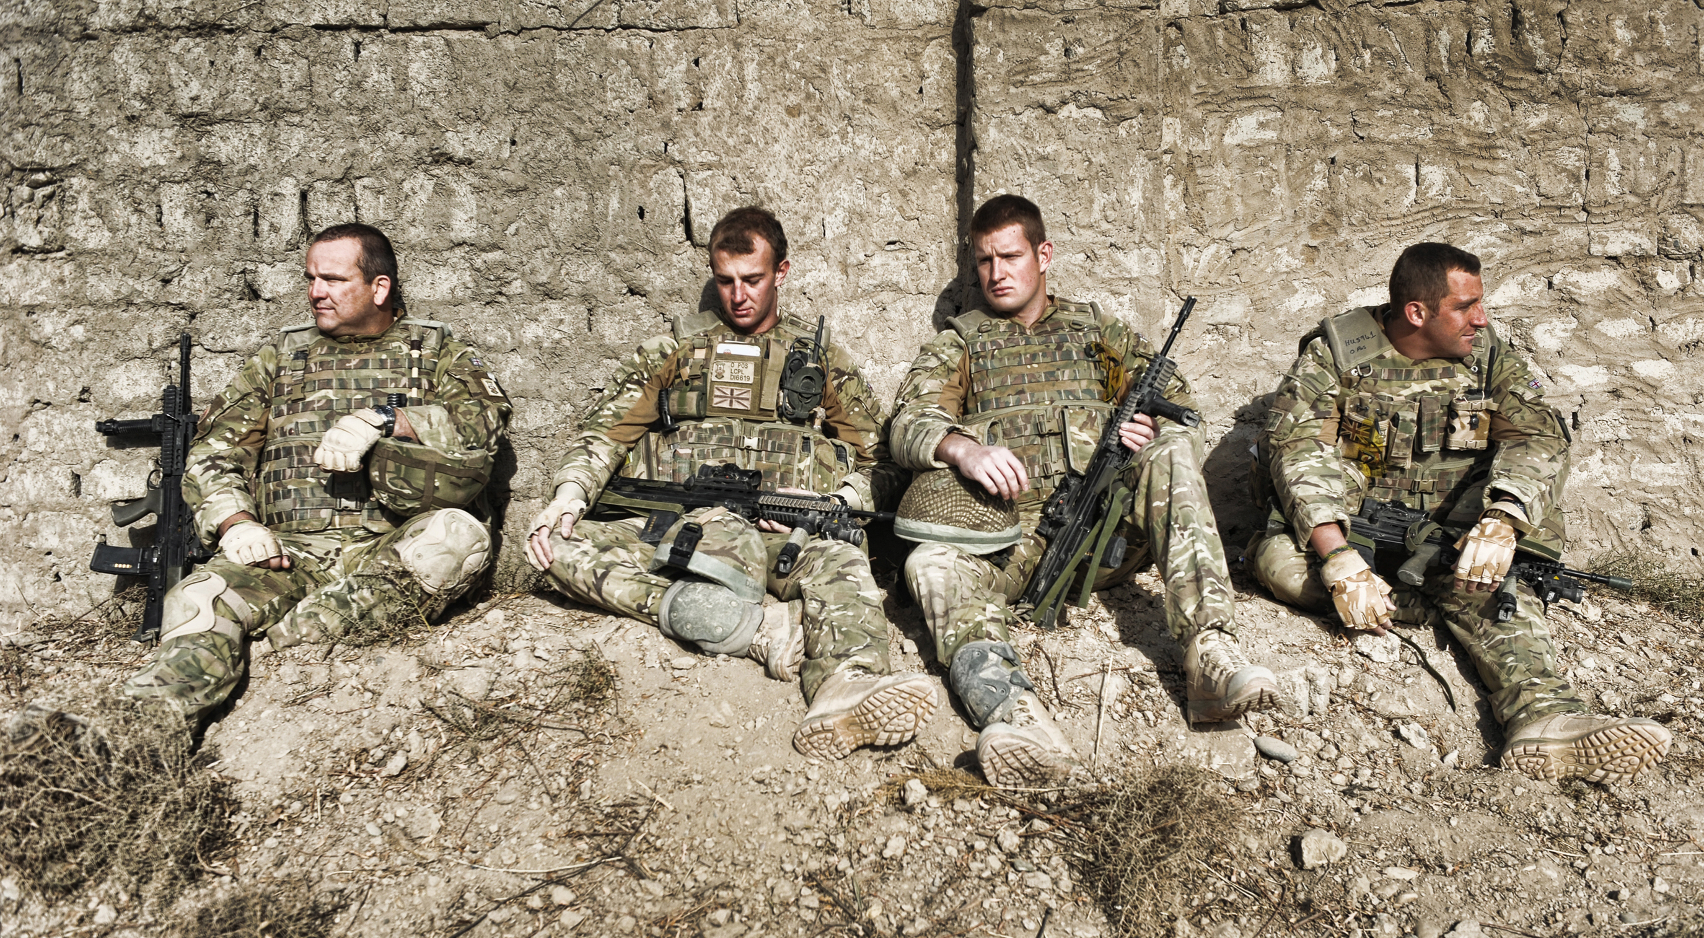
Positives & Negatives Relating To CDRILS
Courage: Failing to ensure the safe evacuation of English teachers in the face of potential danger could be seen as a lack of courage in safeguarding individuals who contribute to education and cultural exchange.
Discipline: Evacuation decisions should reflect disciplined execution of responsibilities, especially concerning the duty of care for personnel. Leaving teachers behind may be viewed as a lapse in this discipline.
Respect for Others: Abandoning individuals at risk, particularly those involved in educational and cultural activities, could be interpreted as a disregard for their well-being and a failure to demonstrate respect for their contributions.
Integrity: Upholding commitments to the safety of personnel is crucial for maintaining the integrity of military operations and decisions. Leaving individuals at risk may be seen as a failure in this commitment.
Loyalty: Ensuring the safety of citizens, including teachers contributing to education, reflects loyalty to the broader mission of safeguarding and serving the interests of the people.
Selfless Commitment: Evacuating individuals at risk, despite challenges, demonstrates a selfless commitment to the safety and welfare of those involved, aligning with the broader service-oriented mission.

Slide 8
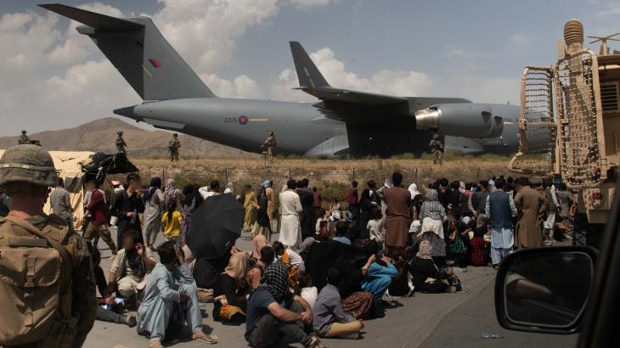
Case Study 2
During the ARAP evacuation, it was reported that the Shia Hazara family were divided. The parents, the oldest (adult) daughter and her husband were successfully evacuated under the ARAP scheme, however they did not have any immediate right of family reunion.
Six children/younger siblings, all under the age of 18, were left behind in Afghanistan, where they are still living without any adult guardian. Despite efforts in making the people organising ARAP approvals understand that the family has underage siblings, they were specifically told not to bring their siblings with them.
Life for any Hazara Shia is difficult in Afghanistan and managing the hardship and risks of this situation as a minor is extremely challenging. The family were advised by lawyers in the UK that they don't have any immediate or straightforward option to bring their children/younger siblings over to the UK, due to the extremely limited rights given to people in their situation to reunite with their family members.
Establishing a family reunion scheme for Afghans who are settled in the UK would allow families such as this one to be reunited, but it also has the potential to protect the lives of minority groups, who are at obvious risk under the Taliban.

Slide 9
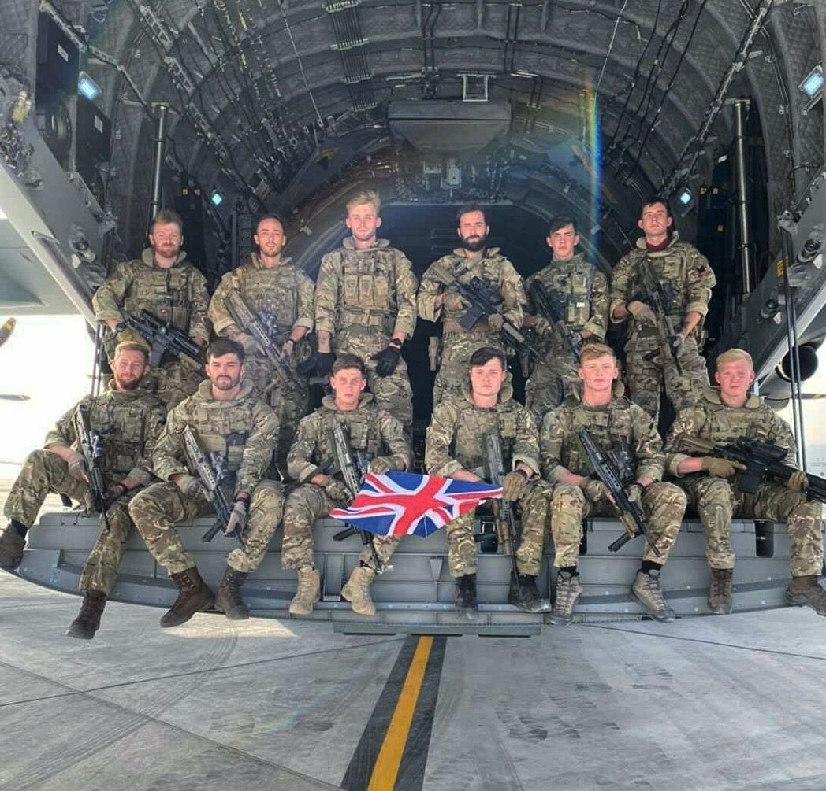
Political, Military, Economical, Social, Infrastructure Impact
Social – This case study also affects the views of the military in the public eye as it wasn’t just this family that had minors left behind in Afghanistan
Infrastructure - The operation was to help evacuate citizens but this left the taliban to have an easier time occupying Kabul as all British troops were pulled after the operation ended.

Slide 10
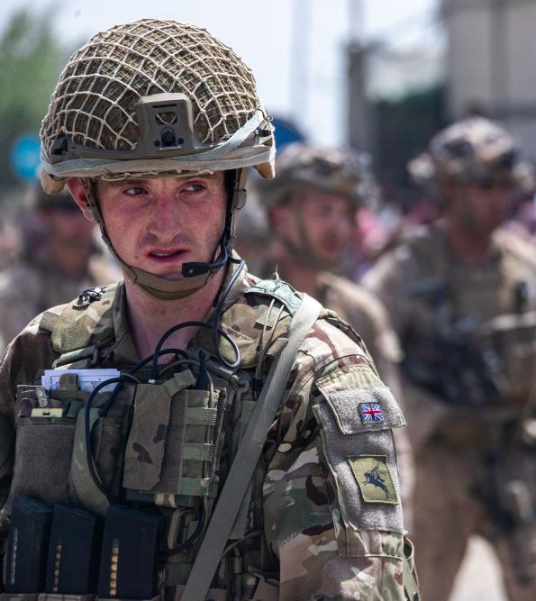
Positives & Negatives Relating To CDRILS
Respect for Others: The efforts to evacuate the parents and older family members under the ARAP scheme show a commitment to their safety, aligning with respect for their well-being.
Loyalty: The family’s inability to bring all their members together may be viewed as a potential fracture in loyalty, given the challenges faced by the younger siblings without adult guardianship.

Slide 11
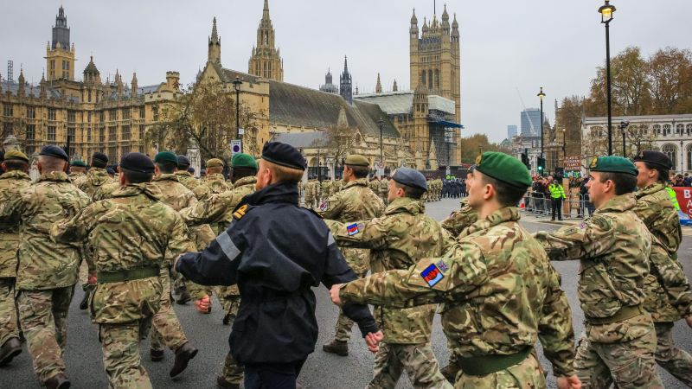
Conclusion
Overall, Op Pitting was a very successful operation and was actually the largest evacuation attempted by the British Army in 70 years, despite all the issues with splitting families and not being able to evacuate everyone under ARAP.
There were many civilians being threatened by the Taliban and were hiding within Afghanistan for a long time before being evacuated under ARAP.
The British Army upheld the majority of it’s CDRILS during this operation and this is the reason why it was as organised and successful as it was.

